Slide 1
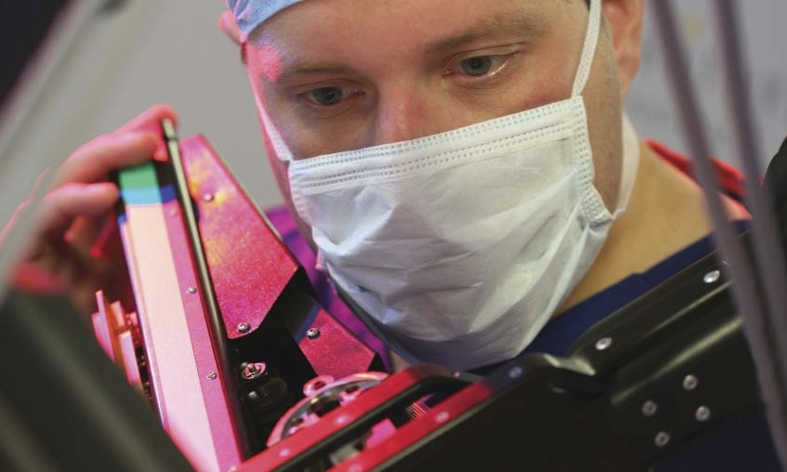
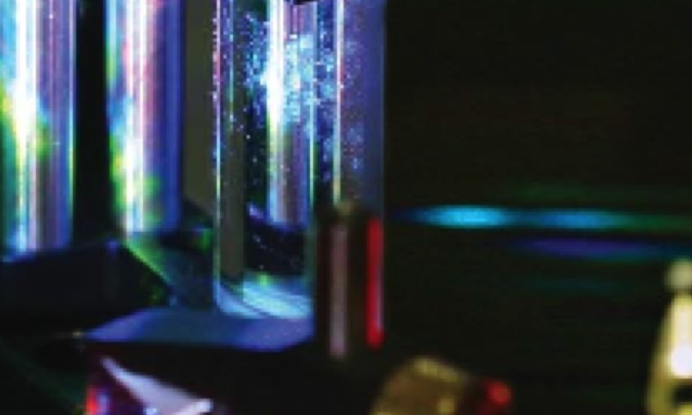
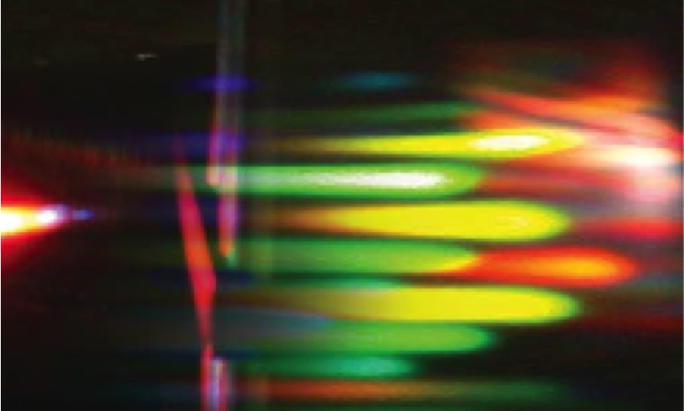
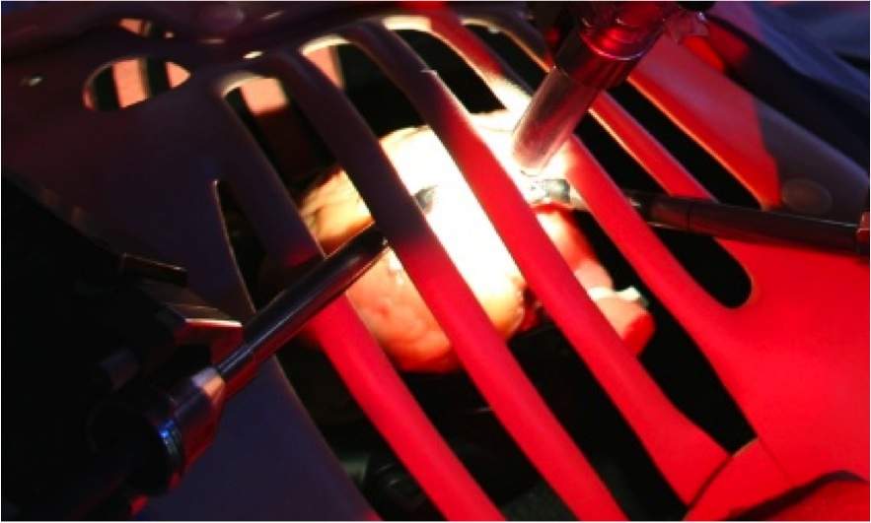
“A real-time intraoperative data mapping device for probe-based measurement using computer vision”
By Hyunggi Chang
Supervised by Fernando Avila-Rencoret, Prof. Daniel Elson
Notes:
Hello everyone,
My name is Hyunggi Chang, and I’m here to present my work – A real-time intraoperative data mapping device for probe-based measurements using computer vision.
Before I begin, I would like to express a special gratitude to my supervisors: Professor Daniel Elson and Fernando Avila-Rencoret, for giving me this amazing opportunity to delve into computer vision and biophotonics, and supporting me throughout the research project.

Slide 2
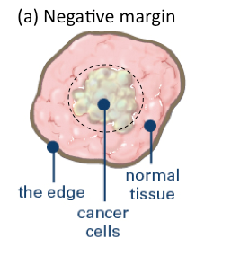
Motivation
The key factor in survival after a cancer surgery is to resect all existing malignant cancer in the body at a negative margin.
This is difficult when the tumour is visually ambiguous.
Biopsy
Figure 1. Visualised negative margin[1]
[1] : breastcancer.org
Notes:
The motivation for this project comes from spotting an extremely inefficient process during cancer surgeries.
During a cancer surgery, the surgeon aims to achieve two things::
1st – to remove all the malignant cancer in the body
2nd – and to preserve as much healthy tissue as possible.
This is done by resecting the cancer at a negative margin, as you can see on the figure – leaving a safety margin around the cancer cells.
However, this can often be difficult, when the border between tumour and the healthy tissue is visually ambiguous (figure)
So, generally what we do is that we take a biopsy at this ambiguous region, but this method suffers from 2 drawbacks.

Slide 3
Motivation
Histology analysis - 30 minutes per biopsy
Average 8-10 hours per surgery [2].
Surgical theatre
Locate tumour
Take biopsy
Confirm negative margin
Locate tumour
…
Outside the theatre
Transport biopsy
Prepare analysis
Analyse the biopsy
Bring back the result
Avg. 29 mins
Figure 2. Cancer surgery procedure
[2] : D.R.Leff et al, 2017
Notes:
When we take a biopsy, we send it to a pathology lab to be examined under histology analysis, which basically tells us whether there is any remaining cancer or not.
But this process of taking a biopsy, transporting it to the lab, analyse it, and bringing back the results, can take up to 30 minutes per biopsy. Meanwhile, the patient must serve an idle time as well, which leads to patient discomfort. This also results in cancer surgeries taking average of 8-10 hours, of which a considerable amount of time is wasted just for waiting for the results of biopsies.
This process also affects the pathology lab, by using valuable resources, personnel and time of the pathology lab, which could have been used for other purposes.

Slide 4
Motivation
Sampling error - The biopsy site is chosen by a subjective decision
In the case of diagnosis of Barrett’s oesophagus, there have been cases resulting false negatives due to incorrect sampling [3]
[3] : L.B.Lovat et al., 2006
Notes:
The second drawback is the sampling error – A biopsy must be taken at an appropriate place to provide the correct information to determine whether to take further excision or not.
Without the assistance from a skilled pathologist, there is a risk of sampling error when the biopsy is taken by the surgeon only.
In the case of diagnosing Barrett’s oesophagus, there has been reports in detecting false negatives due to incorrect sampling.

Slide 5
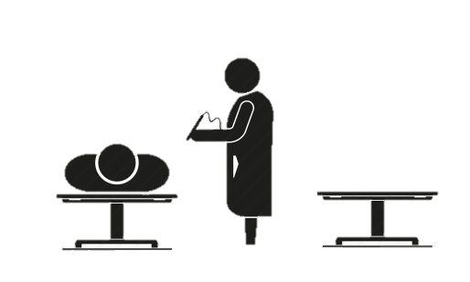
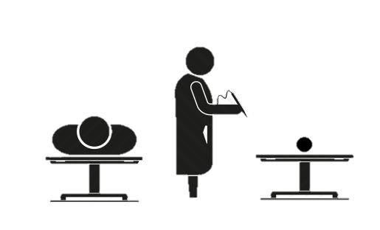
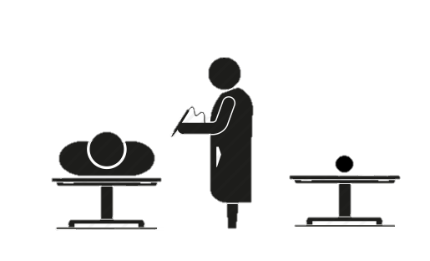
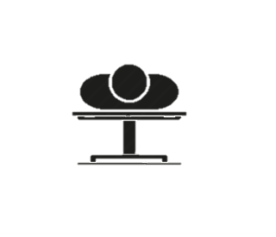
Proposed solution
Cancer Screen
Figure 3. Proposed method
Notes:
So to tackle these problems: what I propose is that if we equip the surgeon an ability to diagnose tissue types themselves, then we don’t need to spend so much time and resources in taking biopsies.
The figure represents an ideal workflow when the surgeon alone can perform a tissue diagnosis.
First, prior to the surgery we do a cancer screening on the patient to roughly know where the cancer cells are.
Second, we perform tissue diagnosis to find the border between the tumour and healthy tissue, and excise the tumour.
Third, we analyse the excised tumour on the resection plane. If any tumour is detected, then it should mean that negative margin has not been achieved, hence further excision is required, going back to the second step.
Finally, we analyse patient body on the resection plane for a final check.

Slide 6
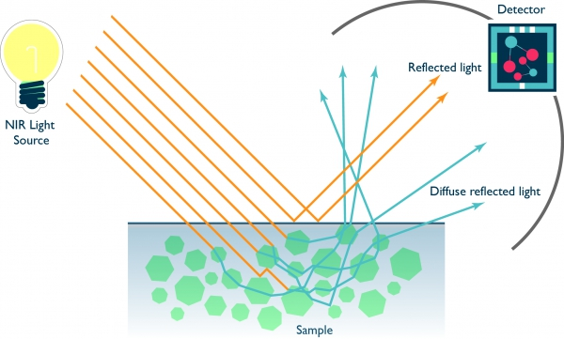
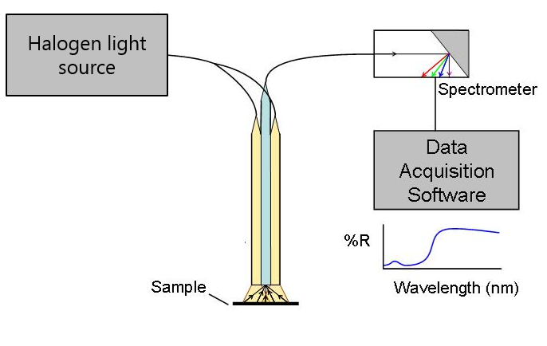
Proposed solution
Equip the surgeon with an ability to:
Perform tissue diagnosis themselves
Optical biopsy - Diffuse reflectance spectroscopy (DRS)
Figure 4. Diffuse reflectance light scattering
Figure 5. Spectroscope schematic
Notes:
There are many ways to diagnose the tissue for example, OCT, Mass spectrometry, Raman spectroscopy etc. But we chose an optical biopsy method called diffuse reflectance spectroscopy, abbreviated as DRS, which is an intraoperative technique that uses elastic light scattering as a diagnostic tool. The previous studies have shown a strong results in tissue diagnosis, and its affordability.
But DRS can only achieve a point-space data at one time, so unlike other wide-field imaging devices like OCT, there is no spatial information to describe where the DRS data is taken from Waldock et al.’s research used a harmonic scalpel to leave visible damages onto the tissue to locate where the DRS data is taken from, but obviously this is not a good method.

Slide 7
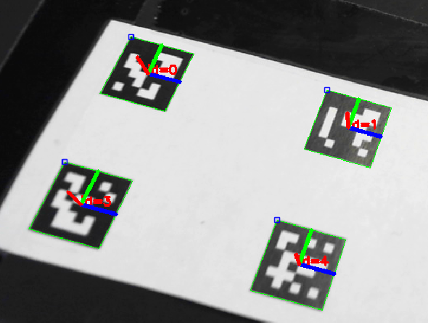

Proposed solution
Equip the surgeon with an ability to:
Provide spatial information to the biopsy
3D tracking of probe locations – OpenCV/ArUco
Figure 6. Example of a ArUco fiducial marker
Figure 7. Fiducial marker detection
Notes:
To locate the optical biopsy position accurately, a 3D tracking of the DRS probe is necessary. There are many ways to track a probe instrument in intraoperative setting, for example, IMU tracking, electromagnetic tracking, robot kinematic tracking, optical tracking, vision-based tracking etc.
I have chosen to use vision-based fiducial marker tracking, since we need a camera for visualise where the DRS has scanned anyway, and also this method is very cheap and requires relatively low computational power. There are many fiducial marker libraries and computer vision libraries out there, but I’ve decided to use OpenCV and AruCo marker library for its simplicity and compatibility with MATLAB.

Slide 8
System flowchart
Input
Processing
Output
RGB Camera
Calibration board
Calibrated RGB image
ArUco pose calculation
Probe-tip estimation
Visualisation
Pre-determined geometry
Sync block
DRS Probe
White Standard
Calibrated spectrogram
Classification
Figure 8. Expected system flowchart
Notes:
The expected system flowchart is as follows:
We have 2 inputs: Raw RGB images from RGB camera, and Raw spectrogram from DRS probe.
Both inputs need to be calibrated prior to the use, using calibration board and white standard respectively.
From the calibrated RGB image, we can then extract information about the ArUco marker pose, and then we can estimate where the probe-tip is positioned at by using pre-determined geometry of the probe and marker placement.
From the DRS probe, the calibrated spectrogram allows us to do tissue classification, which then by registering the temporal information of the DRS and the tracking data, we can provide spatial information to the DRS data.
Visualising the DRS data with spatial information can inform the surgeon about where he just scanned with the probe, as well as what the tissue under the probe is.
By repeating this process automatically, we can achieve a visualised tumour map in an intraoperative setting.

Slide 9
Engineering requirement
Abstract Kano model (Interview + Literature) / Quality Function Deployment
Basic | Performance | Excitement
High positional accuracy (± 1mm) Sterile | Real-time measurement and visualisation (>5fps) Large workspace (>35cm*25cm) Miniaturisation | Robust to environmental changes (e.g. shadows, temperature) Short calibration time (<10 minutes) Long life-span Cheaper than other methods
Notes:
To find the engineering requirement of the system for the suggested workflow, I had a short interview with the surgeon at St Mary’s hospital in London. By using Abstract Kano modelling and Quality Function Deployment technique based on the interview and the literature, I could figure out the engineering requirement for the system.
To explain about the outcome:
Basic quality is considered as a ‘must’ factor – if this is not built, then surgeon’s dissatisfaction is expected. Even if it is built, we don’t expect any satisfaction.
Performance quality is considered as a ‘make it best as possible’ factor – if this is not built, then the surgeon’s dissatisfaction is expected. If it is built in, then the surgeon’s satisfaction is expected.
Excitement quality is considered as a ‘if implemented, then better’ factor. – If we built this, then surgeon’s satisfaction is expected. But if we don’t build it, we don’t expect any dissatisfaction.
So you can consider it as highest priority to lowest priority from left to right.

Slide 10
Work plan
Milestone | Task | Quality Achievement
 | 2D detection & tracking
1 | 3D tracking | Real-time measurement
2 | Multi-marker probe tracking | Miniaturisation
3 | 3D tracking with Multi-camera system | Workspace
4 | Probe-tip estimation | Positional Accuracy
 | Register DRS + Tracking
5 | Visualisation of probe-tip estimation | Visualisation
Notes:
To achieve this difficult engineering requirement, we must start from having a basic success and then expand the features as we get more successes.
Starting from 2D tracking, to 3D tracking,
Expanding from 1 marker to multi-markers,
Then moving on from single-camera system to multi-camera system
And finalise it with accurately estimating the probe-tip position and then visualising it.
Whilst developing, if there are any opportunities for developing ergonomic features or sterility, or reducing cost, we try to implement them as much as possible.

Slide 11
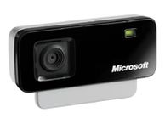
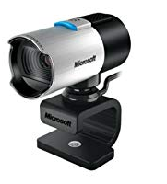
Hardware
Camera (New)
Microsoft LifeCam Studio
Resolution: upto 1920 x 1080
Autofocus, Autoexposure, Auto-white-balance.
Laptop
CPU: Intel Core i7 4850HQ 2.30GHz
RAM: 16Gb
Camera (Old)
Microsoft VX-700
Resolution: 640x480
Fixed focus
Figure 9. Microsoft VX-700
Figure 10. Microsoft LifeCam Studio
Notes:
For this project, the following hardware are used, and all the experiments can be repeated using these hardware.
For the computer, I used my own laptop, which the specification can be seen on the slide,
And I started with a camera with a low resolution with fixed focus,
But as the experiment proceeded, I moved onto a FullHD resolution camera with autofocus, autoexposure and auto-white-balance.

Slide 12
Test 1: Calibration methods
Calibration

Slide 13
Test 1.5 Dynamic calibration

Slide 14
Test 2: Minimum marker size available for tracking
2D Planar tracking with 1 camera

Slide 15
Decision 1: New Cameras
Microsoft LifeCam Studio x2
Variable resolutions up to 1920 x 1080
Auto exposure
Auto focus
Auto White-balance

Slide 16
Test 3: Marker detection with LifeCam Studio
Notes:
.

Slide 17
Test 4: 3D tracking
3D tracking with 1 camera

Slide 18
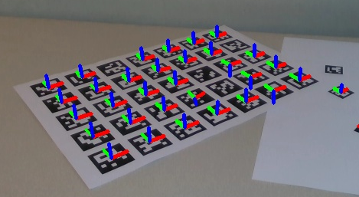
False marker readings
Pose jumps (Major fluctuation)
2 position estimation from 1 marker position.
Occurs when
Marker positioned perpendicular to the camera
Edges not properly detected (self-occlusion, image blur)
Bad calibration
False edge estimation (Minor fluctuation)
False edge reading false centre of the ArUco code.
Occurs when
Edges not properly detected (image blur)
Lighting effects
Notes:
The first one is pose jump. This occurs when 2 position could be assumed from 1 marker position, and is an inherent problem within the Perspective-n-point algorithm, which is the algorithm that is used in OpenCV to estimate pose.
The behaviour is generally seen as a ‘flipped axis’, as the 2nd estimated position has an inverted sign.
The second problem is the false edge estimation. This problem occurs when the edges are not detected properly.

Slide 19
Remedies taken
Pose jump
Change in rotation description
Pre-allocate focus
Subpix estimation
Allocate an appropriate range of detection angles
MAD (Median Absolute Deviation) filters
False edge calculation
Detection parameter change
Exposure / White balance change
Notes:
To tackle these problems, the following remedies were suggested and applied.

Slide 20
3D workspace with one marker

Slide 21
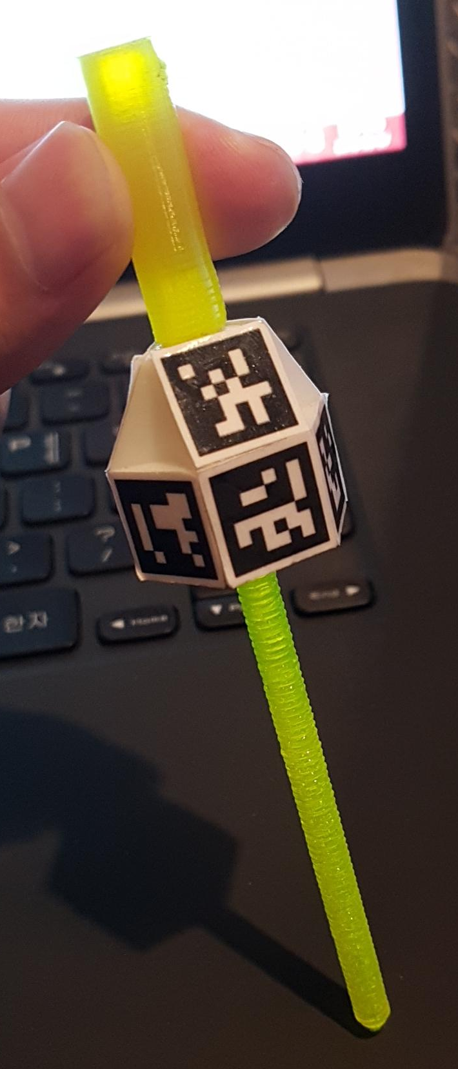
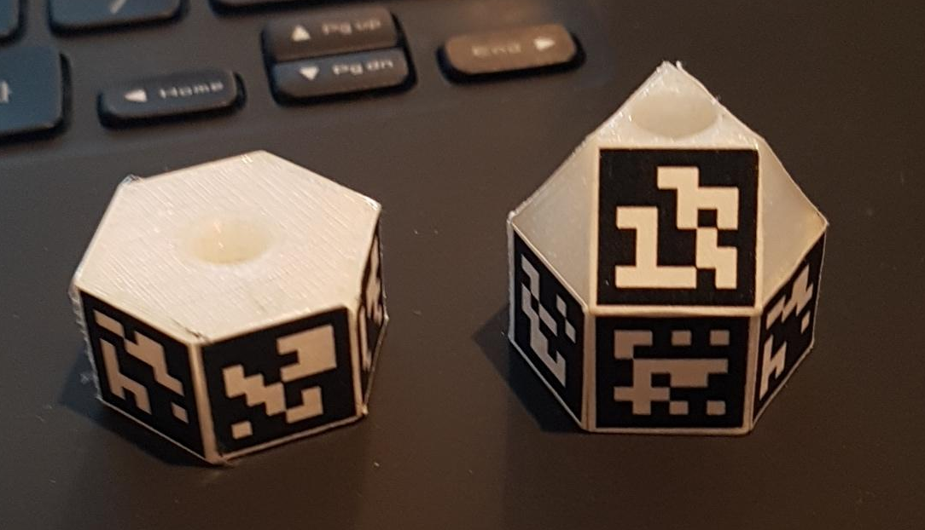
Probe designs
Multi-marker probe tracking
Side-onlys - 6 markers
Side-and-top - 9 markers
Figure 11. Side-only, and Side-and-Top
Figure 12. Side-and-Top on the 3D printed probe

Slide 22
Test 5: Workspace with multi-marker probes

Slide 23
Test 6: Processing time for multi-marker probes

Slide 24
Decision 2: Multi-marker configuration
Side-and-top marker probe is chosen

Slide 25
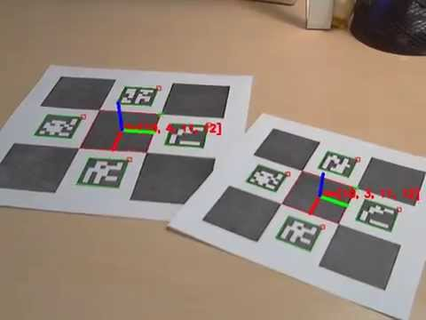
Options for tracking configuration
Probe-tip estimation
2 Extrinsically calibrated monocular cameras with fixed global axis
2 Monocular cameras with fixed global axis
2 stereo cameras with fixed global axis

Slide 26
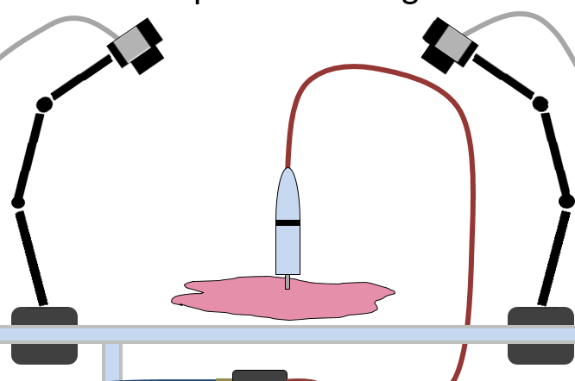

Test 7: 2 Extrinsically calibrated monocular cameras
$Y= R^{−1}∗C∗G$ or $Y= R^{−1}∗B∗C∗G$
Notes:
The 2 extrinsically calibrated monocular cameras use a stereocalibration to find out the extrinsic parameter between the camera 1 and camera 2. This extrinsic parameter is then used as a transformation from the second camera to the first camera.
The orange ball represents the global axis in this diagram
Here, the transformation schematic is Yellow = Inverse red * Cyan * Green, or Yellow = Inverse red * black * cyan * green.
However, this did not take place as the reprojection error for the stereocalibration was way too high.

Slide 27
Test 7: 2 Extrinsically calibrated monocular cameras

Slide 28

Test 8: 2 Monocular cameras with fixed global axis
$Y= R^{−1}∗C∗G$
Notes:
The 2 monocular camera system is basically the 2 separate systems, but they share the same global axis.
The accuracy of this system has already been proven in the 2D and 3D tracking phase.
The transformation schematic here is the yellow = red

Slide 29
Test 8: 2 Monocular cameras with fixed global axis

Slide 30
Test 9: 2 Stereo cameras with fixed global axis
$Y= R^{−1}∗C∗G$
Notes:
The difference between this test and the previous one is that stereocameras were used instead of single cameras – total 4 cameras are therefore used.
The 2 stereo camera system is basically the 2 separate systems, but they share the same global axis.
The accuracy has to be tested.
The transformation schematic here is the yellow = red

Slide 31
Test 9: 2 Stereo cameras with fixed global axis

Slide 32
Comparisons of tracking configurations

Slide 33
Decision 3: Tracking configuration
2 Mono cameras with fixed global axis

Slide 34
Test 10: Validation of DRS equipment
Parallel threading DRS functions
Classification of phantom data using Support Vector Machine (SVM)

Slide 35
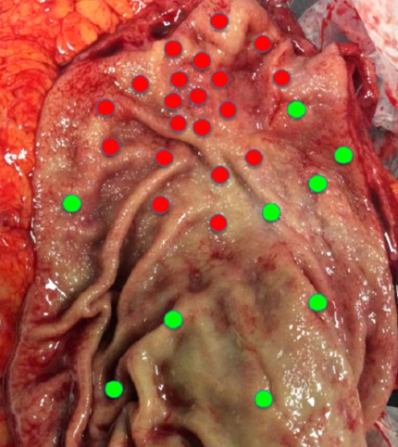
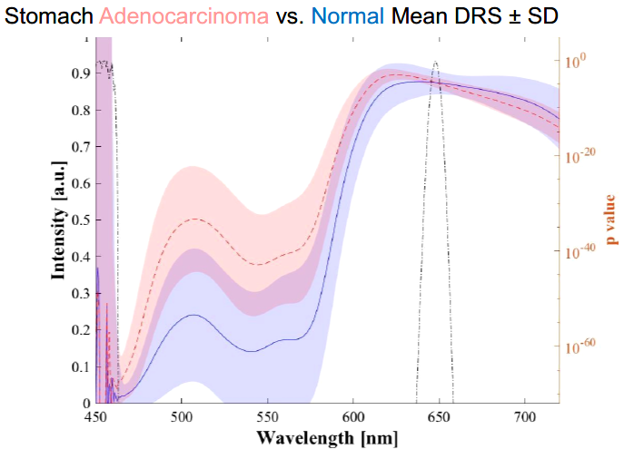
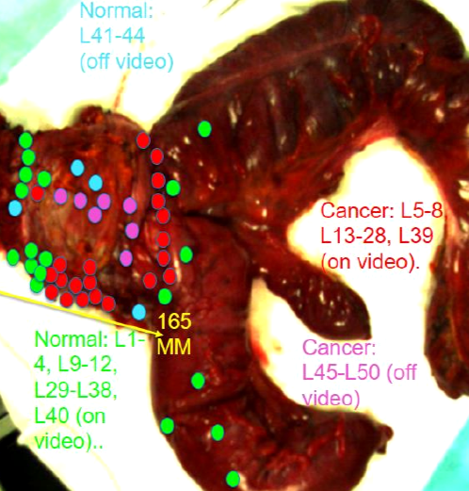
Clinical validation results from co-project
[3] : Waldock et al, 2018

Slide 36
Temporal tracking and registration
Registration of DRS to tracking
DRS collection is faster than visual tracking information collection.
Options:
Direct linear interpolation between detection frames
Non-linear interpolation using Kalman filter

Slide 37
Test 11: Linear interpolation

Slide 38
Test 11: Linear interpolation

Slide 39
Test 12: Kalman filter

Slide 40
Test 12: Kalman filter

Slide 41
Decision 4: Temporal Tracking
Linear interpolation

Slide 42
Summary
Established a robust and ergonomic calibration method
Successful 2D tracking using ArUco markers
Successful 3D tracking using ArUco markers
Successful expansion to multi-marker probe design.
Successful establishment of tracking configuration
Successful registration of DRS to tracking data
Visualisation not completed
Validation not completed

Slide 43
Limitations and future work
Limitations:
The webcams tend to heat up in use, which affects the lens configuration hence the error increases.
Slow processing due to weak CPU processing power.
Future work:
Visualisation of the DRS data.
Validation of the system

Slide 44
Thank you for listening Q&A

